Slide 1
ORM Performance
Notes:
http://blog.jhades.org/open-session-in-view-pattern-pros-and-cons/
https://developer.jboss.org/wiki/OpenSessionInView#jive_content_id_What_about_the_extended_Session_pattern_for_long_Conversations
Not in 3 tier…not with services…ONLY with FULL stack on machine !!!!
Extended EntityManagers are not thread-safe, hence they must not be used in concurrently accessed beans (which Spring-managed singletons usually are
TODO::
Pagination
DTO [ faster??] – only “necessary” fields
JPA DISTINCT is “passed” to SQL – which can be redundant & cause performance problems
http://in.relation.to/2016/08/04/introducing-distinct-pass-through-query-hint/

Slide 2
Performance Considerations
Object Relational Mapping tools provide an increase in productivity
Removes the necessity of “handcrafting” boilerplate** SQL code.
HOWEVER
Lack of “insight” into the interactions with the database can reduce performance
Without proper consideration of performance, scalability is also restricted.
On the other hand
A good ORM Framework has resources available for optimization.
With the right approach, you can improve performance BUT
Ultimately You Need a DBA Expert
Someone on the team who understands how a RDB works [Database design].
Knowing SQL – is not database design
** rolled steel for making boilers

Slide 3
Approach to Performance
You should not do preemptive optimization
Within reason, you should not care about optimization unless you need to. You need to after you have implemented, done measurements and found issues.
You should identify the scenarios that cause problems and then optimize to fix them.
Obviously the focus of improvement is fetching relationships.
Obviously
The default Fetch strategy is fetchType.LAZY
Although
Better performance comes from eager loading relationships that are always used
REMEMBER:
Implementation involves functionality & code stability
Performance tuning comes AFTER

Slide 4
Hibernate FETCH Strategy
Hibernate NOT JPA
Select fetching: a second SELECT [ per parent N] is used to retrieve the associated collection. [DEFAULT] [N+1 Fetches] @Fetch(FetchMode.SELECT)
Join fetching: associated collections are retrieved in the same SELECT, using an OUTER JOIN. [ 1 Fetch] [EAGER] @Fetch(FetchMode.JOIN)
Subselect fetching: a second SELECT is used to retrieve the associated collections for all entities retrieved in a previous query or fetch. [2 Fetches]
@Fetch(FetchMode.SUBSELECT)
Batch fetching: Optimization of Select Fetching. Associated collections are fetched according to declared Batch Size(N/Batch Size) + 1; @BatchSize(size=n)
EXAMPLE:
@Fetch(FetchMode.SUBSELECT)
private Set<Address> addresses;
Notes:
WHEN to USE:
http://www.solidsyntax.be/2013/10/17/fetching-collections-hibernate/

Slide 5
Hibernate Fetch Strategy Issues
Select
N+1 TBA [To Be Avoided]
Join
Cartesian – need to watch collection sizes; can be useful strategy
SubSelect
depends on the “parent” query. If parent Query is complex, it could
have performance impacts.
If fetch=FetchType.LAZY need to “hydrate” children
BatchSize
# of Fetches “unknown” UNLESS size of parent is constant
Batch fetching is often called a blind-guess optimization
If fetch=FetchType.LAZY need to “hydrate” children
REMEMBER: fetch=FetchType.LAZY is recommended Default
Notes:
The query may be very complex, e.g. using a lot of other tables and filtering by non-indexed columns

Slide 6
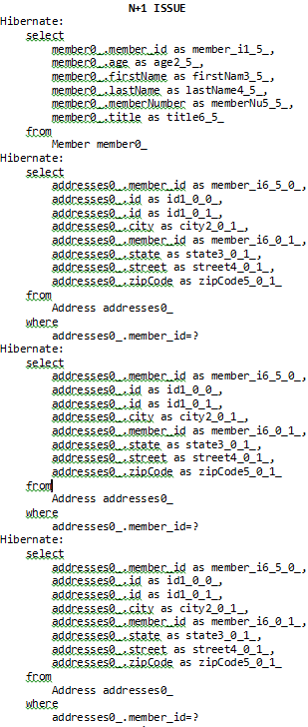
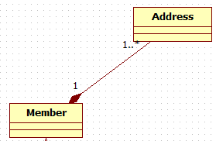
N+1 Problem
Example N = 3
Member has a OneToMany relationship with Address
Declared as Fetch EAGER:
@OneToMany(mappedBy="member",fetch=FetchType.EAGER)
private Set<Address> addresses = new HashSet<Address>();
For
entityManager.createQuery( "from Member”)
.getResultList();
ORM will issue ONE fetch for ALL the Members
&
And N fetches; one for each member’s Address Collection
So for 3 members we have ONE fetch for Members and
THREE fetches for Address collections
Uses “Default” strategy of SELECT

Slide 7
Join Fetching Strategy
Hibernate Annotation: @Fetch(FetchMode.JOIN)
ALWAYS
Causes an EAGER fetch of the child collections
This is because the characteristic of a Join is ONE fetch
Parent & Child TOGETHER
This can only be accomplished by loading the child collection when the parent is fetched [ ~= EAGER fetch]
Best practice: Use Lazy Initialization [NOT Eager]
So we will implement the Join Fetch “Manually”
Notes:
@Fetch(FetchMode.JOIN) will be ignored if you use the Query interface (e.g.: session.createQuery()) but it will be properly used if you use the Criteria interface.
This is practically a bug in Hibernate which was never resolved. It is unfortunate because a lot of applications use the Query interface and cannot be migrated easily to the Criteria interface.
If you use the Query interface you always have to add JOIN FETCH statements into the HQL manually.
________________
For query methods you explicitly have to specify fetch joins in the query definition (which will require a manually declared query) or define an fetch graph to be used for the query method using @EntityGraph (see the reference documentation for details).
_________________________
WITH HIBERNATE
User user = (User) session.createCriteria(User.class) .setFetchMode("permissions", FetchMode.JOIN) .add( Restrictions.idEq(userId) ) .uniqueResult();
WITH HIBERNATE/JPA
Only can do with Spring DATA
WHAT ABOUT ENTITY GRAPH and CriteriaAPI ??
https://dzone.com/articles/eager-fetching-code-smell

Slide 8
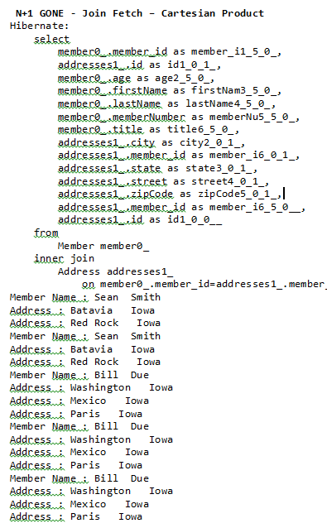
Join == Cartesian “LIKE” Product Problem
2 Members
X
# Address/Member
For sets A and B, the Cartesian product is A × B
For sets A,B and C, the Cartesian product is A × B × C - etc.
Member has a OneToMany relationship with Address
@OneToMany(mappedBy="member",fetch=FetchType.LAZY)
private Set<Address> addresses = new HashSet<Address>();
For:
Query query=entityManager.createQuery("SELECT m
FROM Member AS m JOIN FETCH m.addresses AS a");
ORM will do ONE FETCH BUT will generate duplicates
]
ORM NOTE: “Product” =
∑ # Addresses [per Member.
Sean has 2 Addresses so 2 copies ; Bill has 3 so 3 copies
Notes:
@Fetch(FetchMode.JOIN) will be ignored if you use the Query interface (e.g.: session.createQuery()) but it will be properly used if you use the Criteria interface.
This is practically a bug in Hibernate which was never resolved. It is unfortunate because a lot of applications use the Query interface and cannot be migrated easily to the Criteria interface.
If you use the Query interface you always have to add JOIN FETCH statements into the HQL manually.
JPA spec 2.1 Page 178 – identifies duplicates… a Parent for every child entry
https://download.oracle.com/otn-pub/jcp/persistence-2_1-fr-eval-spec/JavaPersistence.pdf?AuthParam=1551590210_e1fe2d2a111885c6d1c5d5314ae1efb2
the JPA specification states that the returning entities resulting from a parent-child JOIN might contain object reference duplicates.
SELECT d
FROM Department d LEFT JOIN FETCH d.employees
WHERE d.deptno = 1
A fetch join has the same join semantics as the corresponding inner or outer join, except that the related
objects specified on the right-hand side of the join operation are not returned in the query result or otherwise
referenced in the query. Hence, for example, if department 1 has five employees, the above query
returns five references to the department 1 entity.

Slide 9
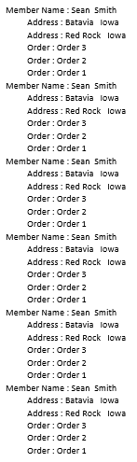
Join == Cartesian Product Problem
2 Addresses
X
3 Orders
2 Addresses
X
3 Orders
For sets A and B, the Cartesian product is A × B
For sets A,B and C, the Cartesian product is A × B × C - etc.
Member has a OneToMany relationship with Address & Order
@OneToMany(mappedBy="member",fetch=FetchType.LAZY)
private Set<Address> addresses = new HashSet<Address>();
@OneToMany(mappedBy="member",fetch=FetchType.LAZY)
private Set<Order> orders = new HashSet<Order>();
For:
Query query = entityManager.createQuery("SELECT m FROM Member
AS m JOIN FETCH m.orders as o
JOIN FETCH m.addresses as a where m.id = :id");
ORM will do ONE FETCH BUT will generate duplicates
ORM NOTE: Product = 2 Addresses X 3 Order
SIX Members
Notes:
We can ALSO do a Join FETCH of Address against ALL Members & get a Cartesian-like result see OLD Slide
@Fetch(FetchMode.JOIN) will be ignored if you use the Query interface (e.g.: session.createQuery()) but it will be properly used if you use the Criteria interface.
This is practically a bug in Hibernate which was never resolved. It is unfortunate because a lot of applications use the Query interface and cannot be migrated easily to the Criteria interface.
If you use the Query interface you always have to add JOIN FETCH statements into the HQL manually.
JPA spec 2.1 Page 178 – identifies duplicates… a Parent for every child entry
https://download.oracle.com/otn-pub/jcp/persistence-2_1-fr-eval-spec/JavaPersistence.pdf?AuthParam=1551590210_e1fe2d2a111885c6d1c5d5314ae1efb2
the JPA specification states that the returning entities resulting from a parent-child JOIN might contain object reference duplicates.
SELECT d
FROM Department d LEFT JOIN FETCH d.employees
WHERE d.deptno = 1
A fetch join has the same join semantics as the corresponding inner or outer join, except that the related
objects specified on the right-hand side of the join operation are not returned in the query result or otherwise
referenced in the query. Hence, for example, if department 1 has five employees, the above query
returns five references to the department 1 entity.

Slide 10
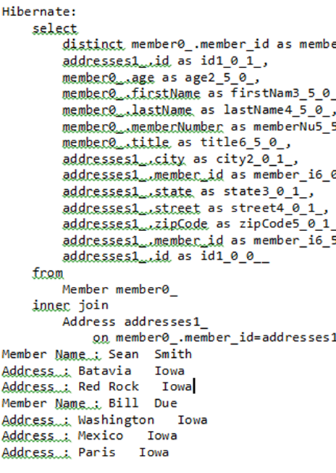
Clean Up
The Cartesian Product Data
Query query=entityManager.createQuery("SELECT DISTINCT m
FROM Member AS m JOIN FETCH m.addresses AS a");
DISTINCT keyword removes duplicates
However
It accomplishes it in Memory [ After DB fetch]

Slide 11
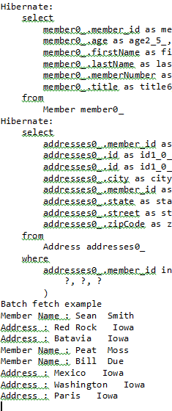
SubSelect Fetch
Declared as Fetch LAZY:
@OneToMany(mappedBy="member",fetch=FetchType.LAZY)
@Fetch(FetchMode.SUBSELECT)
private Set<Address> addresses = new HashSet<Address>();
For FetchMode.SUBSELECT
ORM will do ONE Fetch for All Parents
ORM will do ONE Fetch for All child collections
Need to “Hydrate” collections:
List<Member> members = (List<Member>)this.findAll();
members.get(0).getAddresses().get(0);
We can also do this “Manually” WITHOUT
@Fetch(FetchMode.SUBSELECT)
See DEMO FetchSubSelect
Fetch EAGER does NOT need hydration
Notes:
http://www.christophbrill.de/en_US/hibernate-fetch-subselect-performance/
Subselect where X is original query…
(i.e. “SELECT … FROM Y WHERE parentId in (X)”)
Where as Batch requires passing all the ID to DB SERVER:
“SELECT … FROM Y WHERE parentId IN (?, ?, ?, …) each ? Is an ID…

Slide 12
Batch Size Fetch
Declared as Fetch LAZY:
@OneToMany(mappedBy="member",fetch=FetchType.LAZY)
@Fetch(FetchMode.SELECT)
@BatchSize(size = 3)
private Set<Address> addresses = new HashSet<Address>();
Need to “Hydrate” collections:
List<Member> members = (List<Member>)this.findAll();
for (Member member : members)
if (!member.getAddresses().isEmpty())
member.getAddresses().get(0);
In example, ORM will do ONE Collection Fetch
[based on batch size = # parents]
NOTE:
In example # members = 3; BatchSize = 3; 1 Collection fetch
If # members = 3; BatchSize = 2; 2 Collection fetches
If # members = 3; BatchSize = 1; 3 Collection fetches
Fetch EAGER does NOT need hydration
Notes:
The batch size can also be set globally by setting the hibernate.default_batch_fetch_size property for the session factory.
Hibernate will ignore the fetch mode if the query was built by the entity manager.
Will work with EAGER
“SELECT … FROM Y WHERE parentId IN (?, ?, ?, …)”. Adding large batch sizes will generate more questionmarks. This forces Hibernate to transfer many IDs to the database server, where using a subselect might simply be faster (of course only if the SQL query used in the subselect is fast).
hibernate.jdbc.batch_size - inserts updates how many insert/updates before commit…
hibernate.default_batch_fetch_size -- “GLOBAL” value for All SELECTS [ and ONLY for SELECT not JOIN,SUBSELECT… --- @BATCHSIZE overrides
https://dzone.com/articles/hibernate-tuning-queries-using
PAGING:
setMaxResults - sets the number of maximum rows to retrieve from the database
setFirstResult - sets the first row to retrieve
Hibernate actually doesn't issue an SQL statement with a LIMIT clause. Instead it fetches all of the records and performs the paging in memory.

Slide 13
Customized Fetching Strategies
HOW to Access an Association [for Performance Tuning]
WHEN is FetchType.LAZY OR FetchType.EAGER
The Default Fetching Strategy
is not used to customize fetching [ it is not efficient]
Use & Master The Query API
to override the Default Fetching Strategy for custom fetching
Understand & Use The Join fetch & SubSelect
Avoid the N+1 fetch problem as a rule of thumb
FetchMode.SELECT(Default) is extremely vulnerable to the N+1 problem
Use Lazy Initialization
Regardless of your fetching strategy WHEN you fetch takes “priority”
*** Non-lazy initialization [FetchType.EAGER ] always loads the relationship ***
REMEMBER - Optimize Selectively
using left join fetch in HQL. This tells Hibernate to fetch the association eagerly in the first select, using an outer join.

Slide 14
Main Point
An eager fetch strategy often creates inefficient queries. To increase performance we can configure the entity associations with a lazy fetch strategy and fetch them in a more efficient manner.
Science of Consciousness: As we grow in creative intelligence we enjoy the advantage of increased efficient action..

Slide 15
Second Level Cache
A second-level cache
A local store of entity data managed by the persistence provider to improve application performance
Improves performance by avoiding expensive database calls
Keeps the entity data local to the application
Transparent to the application
Available across all users [ Application wide]
Complements First level cache

Slide 16
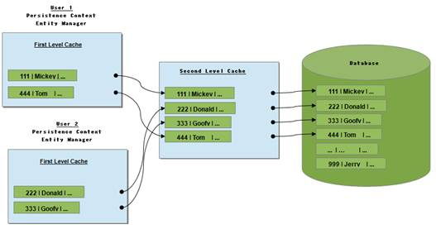
Level 2 Cache

Slide 17
Query for Entity
Check First level Cache
If Found:
Return Entity
If not Found:
Check Second level Cache
If Found:
Update First Level Cache
Return Entity
If not Found:
Execute DB Query
Update Second Level Cache
Update First Level Cache
Return Entity

Slide 18
Cache Concurrency Strategy
Transactional:
Read-Mostly data where it is critical to prevent stale data in
concurrent transactions, in the rare case of an update.
Full Lock on all entities in transaction. Performance issue.
Read-write:
Read-Mostly data where it is critical to prevent stale data in
concurrent transactions, in the rare case of an update.
Supports Repeatable Read Isolation - Allows phantom reads
Nonstrict-read-write:
No guarantee of consistency between the cache and the database. Use this strategy if data hardly ever changes and a small likelihood of stale data is not of critical concern.
Read-only:
Suitable for data which never changes. Use it for reference data only.
Simplest and optimal performing strategy.

Slide 19

READ Only – Low Hanging Fruit
Read-only caches are easy to handle
It is immutable (Modification Forbidden )
No consistency issues.
Always a good candidate for second level caching
Read-write caches are more “subtle” in their behavior.
Interaction with the Hibernate session can lead to unwanted behavior.
The benefits of the C in ACID are compromised if cache is out of sync with DB
Eventual consistency is NOT a primary use case of Relational DBs in an Enterprise.

Slide 20
Second Level Cache Decision
Database queries slow?
Second Level Cache is the final resort
Optimize ORM Queries
Make sure the fetching strategy is properly designed,
Remove N+1 query problems
Involve the DBA [Expert]
Employ indexes
Investigate data base solutions [ e.g. paritioning]
If performance is still an issue THEN consider a second level cache
Notes:
Data partitioning allows an application to scale its data across more than one database machine. Data partitioning is supported at the entity level to allow a different set of entity instances for the same class to be stored in a different physical database or different node within a database cluster.
INDEX – just like a book index…

Slide 21
Two Types of Cache
Second Level Cache
Second level cache is a key-value store.
Applicable for accessing an entity by Primary Key
These will hit Second Level Cache
member = memberService.findOne(1L);
entityManager.createQuery("SELECT m FROM Member m where
m.id= :member");
These will NOT hit cache
entityManager.createQuery("SELECT m FROM Member AS m JOIN FETCH
m.addresses AS a where m.id= :member");
entityManager.createQuery("select m from Member m where
m.memberNumber =:number");
Query Cache
Applicable for accessing entities by specific query
The two preceding queries are Query Cache “candidates”
NOTE: Query cache store the query in query cache and the actually entities in the Second Level Cache

Slide 22
Configuring resources for Caching
For Second Level Cache:
@Cache(usage = org.hibernate.annotations.CacheConcurrencyStrategy.READ_ONLY)
public class Member {
For Query Cache:
@NamedQuery(name="Member.findById",
query="select m from Member m where m.memberNumber = :memberNumber ",
hints={ @QueryHint(name="org.hibernate.cacheable", value="true") } )

Slide 23
Configuration
pom.xml
<dependency>
<groupId>net.sf.ehcache</groupId>
<artifactId>ehcache</artifactId>
</dependency>
<dependency>
<groupId>org.hibernate</groupId>
<artifactId>hibernate-ehcache</artifactId>
</dependency>
Hibernate Properties
<prop key="hibernate.cache.provider_class">
org.hibernate.cache.EhCacheProvider</prop>
<prop key="hibernate.cache.region.factory_class">
org.hibernate.cache.ehcache.SingletonEhCacheRegionFactory</prop>
<prop key="hibernate.cache.use_second_level_cache">true</prop>
<prop key="hibernate.cache.use_query_cache">true</prop>
Notes:
Ehcache is an open source, standards-based cache that boosts performance, offloads your database, and simplifies scalability. It's the most widely-used Java-based cache because it's robust, proven, full-featured, and integrates with other popular libraries and frameworks.

Slide 24
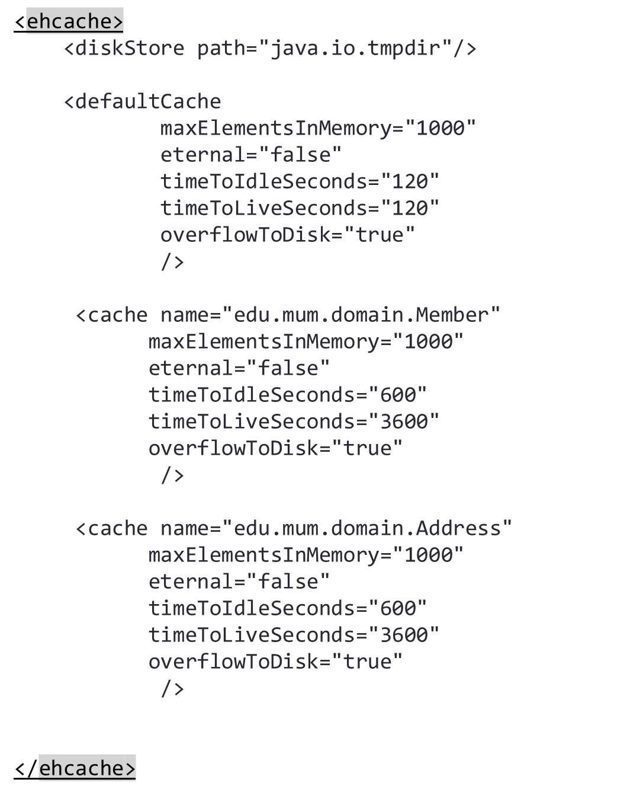
ehCache.xml
The defaultCache is applied to any cache not explicitly configured
Notes:
timeToIdleSeconds – The maximum number of seconds an element can exist in the cache without being accessed. The element expires at this limit and will no longer be returned from the cache.
timeToLiveSeconds – The maximum number of seconds an element can exist in the cache regardless of use. The element expires at this limit and will no longer be returned from the cache.
eternal - Sets whether elements are eternal. If eternal, timeouts are ignored and the element is never expired.
Java.io.tmpdir
In MS Windows the temporary directory is set by the environment variable TEMP.

Slide 25
Spring Cache Abstraction
Applies caching to Java methods
When method is invoked, the abstraction will apply a caching behavior
checks whether the method has been already executed for the given
arguments.
[ Does NOT re-execute the method a second time…]
Will Work across “Query” methods
Does not distinguish between “Second Level Cache” & Query Cache
Handles Both
Spring Cache Abstraction is separate from Hibernate cache
Hibernate Second Level Cache and Spring Cache (method caching)
can co-exist with Ehcache as the underlying provider for both.
Notes:
Methods… AOP …

Slide 26
Cache Abstraction Annotations
The abstraction provides following Java annotations:
@Cacheable:
Put the method returned value(s) into the cache [ READ ONLY]
@CacheEvict:
Remove an entry from the cache [stale or unused…]
@CachePut:
Force a cache entry to be updated [ READ WRITE related]

Slide 27
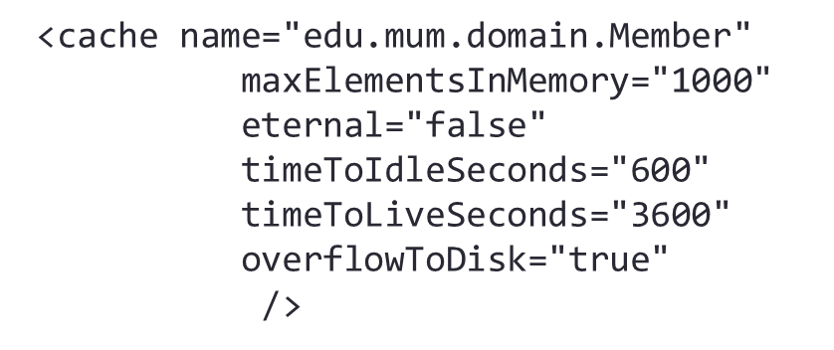
Spring Cache Configuration
Declaration – refers to ehCache.xml resource
@Cacheable("edu.mum.domain.Member")
public Member findOne(Long id) {
return memberDao.findOne(id);
}
XML Configuration
<cache:annotation-driven />
<bean id="cacheManager"
class="org.springframework.cache.ehcache.EhCacheCacheManager">
<constructor-arg ref="ehcacheManager" />
</bean>
<bean id="ehcacheManager" class="org.springframework.cache.ehcache.EhCacheManagerFactoryBean">
<property name="configLocation" value="ehcache.xml" />
</bean>

Slide 28
Main Point
The second level cache can permit more scalability for the application, when the same entities are retrieved by multiple users they could be retained in memory to avoid subsequent accesses to the database, increasing efficiency & speed.
Science of Consciousness: Through the constant practice of Transcendental Meditation, the reactions of mind and body are faster.

